Slide 1
SHORTEST PATH BETWEEN NODES
A KLH PROJECT

Slide 2
TEAM MEMBERS
T.SAINATH REDDY
L.VAMSI KRISHNA
V.ABHIRAM

Slide 3
INTRODUCTION
In computer networks, the shortest path algorithms aim to find the optimal paths between the network nodes so that routing cost is minimized. They are direct applications of the shortest path algorithms proposed in graph theory.
In shortest path routing, the topology communication network is defined using a directed weighted graph. The nodes in the graph define switching components and the directed arcs in the graph define communication connection between switching components. Each arc has a weight that defines the cost of sharing a packet between two nodes in a specific direction

Slide 4
Shortest path node in simple words
Shortest path algorithm :
Route Travelling the packet from source to destination.
Route Means Shortest route.
Function between nodes
Cost
Distance
Traffic & Bandwidth

Slide 5
Explanation
Consider that a network comprises of N vertices (nodes or network devices) that are connected by M edges (transmission lines). Each edge is associated with a weight, representing the physical distance or the transmission delay of the transmission line. The target of shortest path algorithms is to find a route between any pair of vertices along the edges, so the sum of weights of edges is minimum. If the edges are of equal weights, the shortest path algorithm aims to find a route having minimum number of hops.
There will be an example in the next slide so that it will be more clear to understand.

Slide 6
Example of finding shortest path
Consider the diagram as a network and the labelled parts as nodes . B C
So , there’s a Connection between each node and each node has
a function . So , A point is the source and D point is the destination.
We have to find shortest path. A D
For that we have two ways :
One of them is the Tree method. F E
TREE METHOD :
So we have to start from the first point A then , we have to check the outgoing lines from that point and then continue the same with the other points till end.
After sorting all the nodes in the OUTGOING TREE ORDER , we have to note down the number of paths that have formed and then find the distance according to the order.

Slide 7
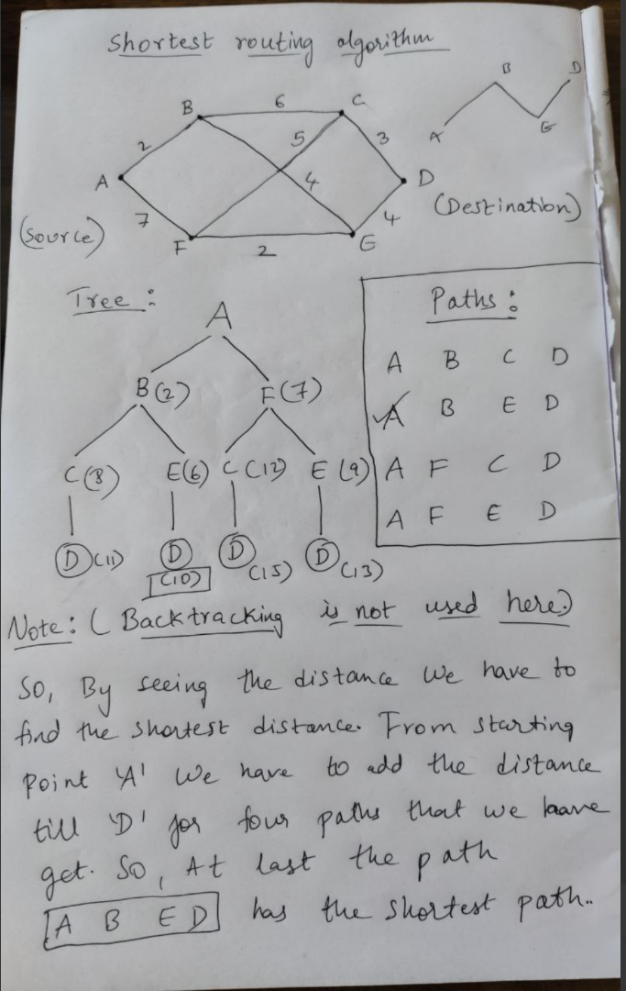
So by this we can easily find
the shortest path between the
nodes using suitable method .
The other method is dijkshtra
method which can be solved by just
checking the incoming and outgoing
nodes and adding all the distances at
last to get the result.
Input − A graph representing the network; and a source node, s
Output − A shortest path tree, spt[], with s as the root node.

Slide 8
Applications of spbn
IP routing to find Open shortest Path First: Open Shortest Path First (OSPF) is a link-state routing protocol that is used to find the best path between the source and the destination router using its own Shortest Path First. Dijkstra’s algorithm is widely used in the routing protocols required by the routers to update their forwarding table. The algorithm provides the shortest cost path from the source router to other routers in the network.
Telephone Network: As we know, in a telephone network, each line has a bandwidth, ‘b’. The bandwidth of the transmission line is the highest frequency that that line can support. Generally, if the frequency of the signal is higher in a certain line, the signal is reduced by that line. Bandwidth represents the amount of information that can be transmitted by the line. If we imagine a city to be a graph, the vertices represent the switching stations, and the edges represent the transmission lines and the weight of the edges represents ‘b’. So as you can see it can fall into the category of shortest distance problem, for which the Dijkstra is can be used.

Slide 9
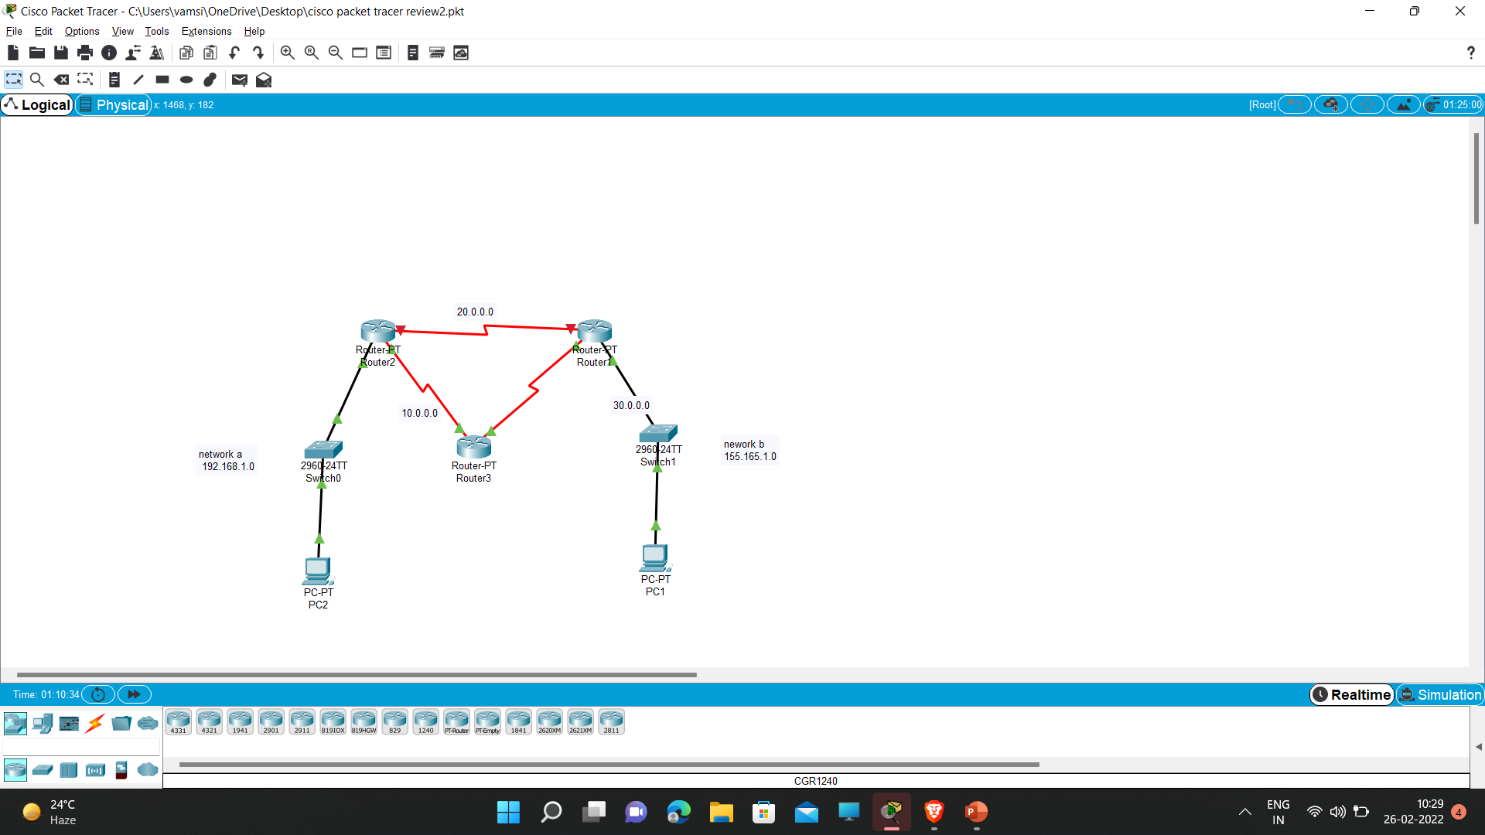
CISCO PACKET TRACER

Slide 10
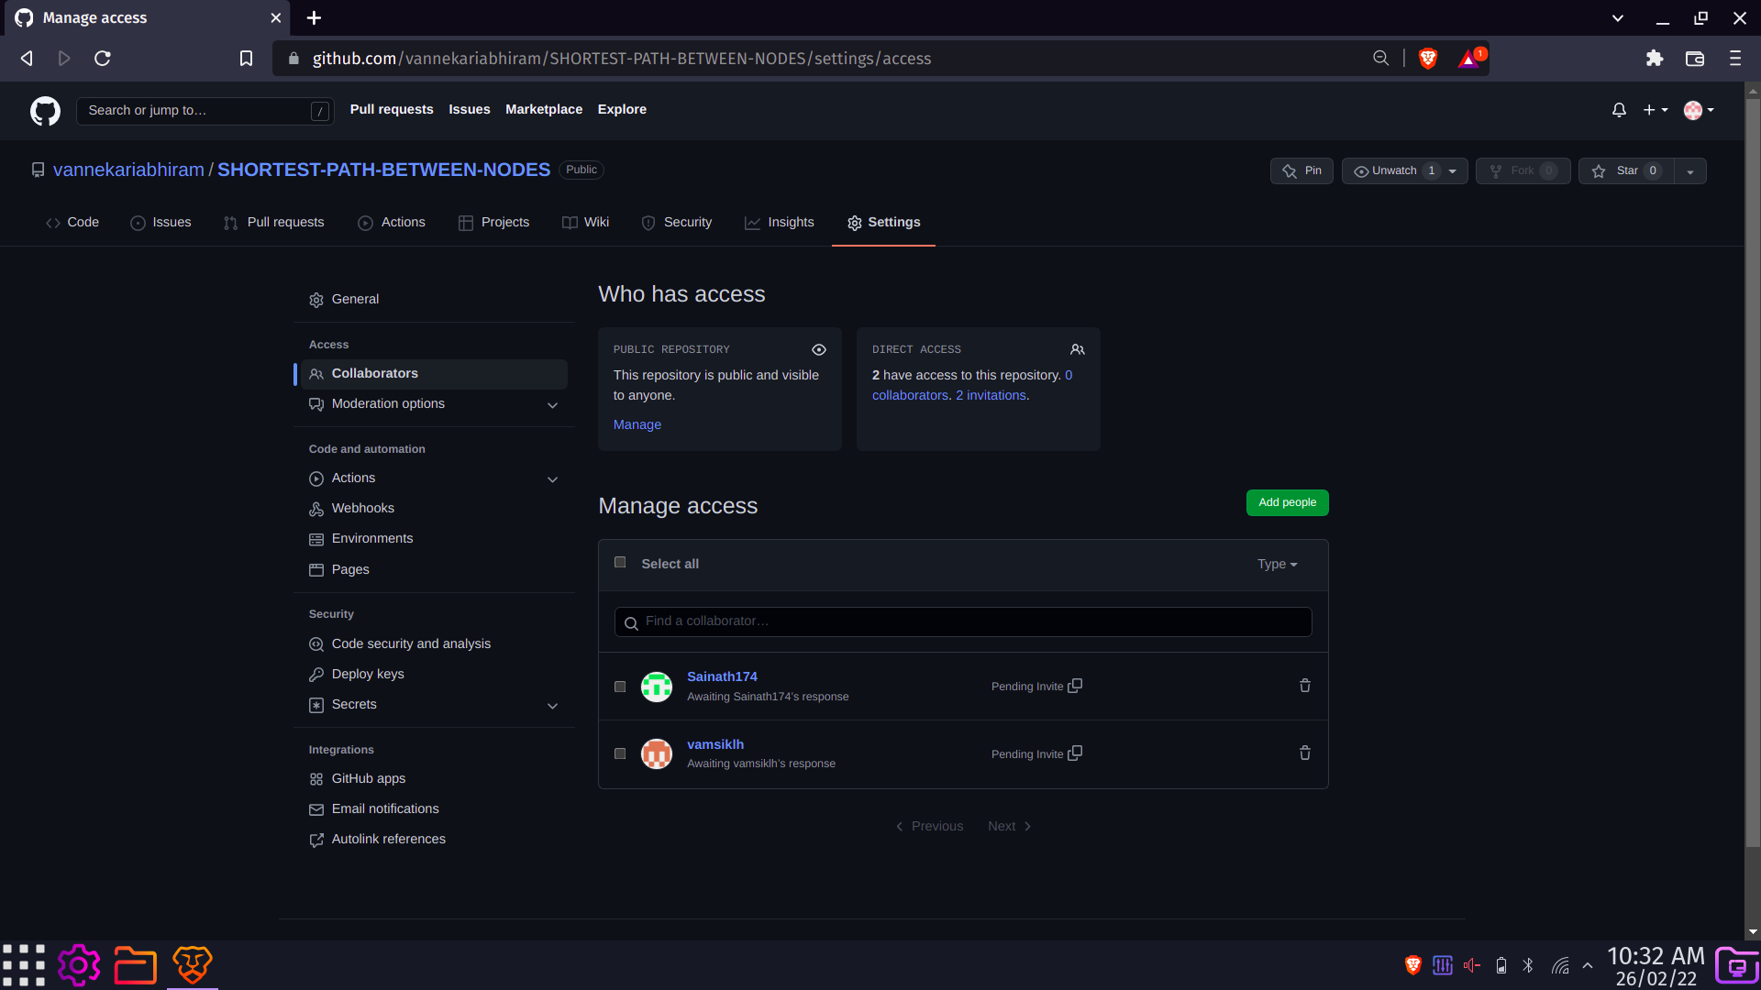
GITHUB SETUP

Slide 11
THANKYOU

